Slide 1



C Data Types
Working with Numbers and Text
SoftUni
Technical Trainers
Software University
https://softuni.bg

Slide 2

Table of Contents
Data types
Working with text
Simple operations
Output manipulation
Data manipulation
Type casting

Slide 3
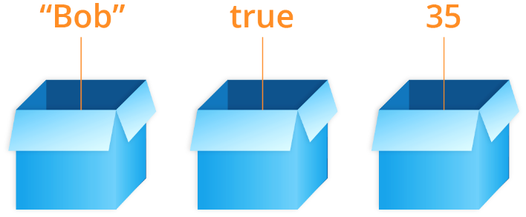
Variables and Data Types

Slide 4
Variables
Computers store and manipulate data
Data is stored inside the memory
Variables have identifier, type and value
Defining and initializing value to a variable:
Variable identifier
int number = 42;
Data type
Variable value

Slide 5
C Data Types
In C programming there is strict definition of the data types
Data types are mainly divided in:
Integers types – representing numbers without floating point value can be signed or unsigned
Floating point types – representing signed real numbers can have floating point value
5

Slide 6
Integer Types
Type | Size | Value range
char | 1 byte | -128 to 127 or 0 to 255
unsigned char | 1 byte | 0 to 255
short | 2 bytes | -32 768 to 32 767
unsigned short | 2 bytes | 0 to 65 535
int | 2 or 4 bytes | -2 147 483 648 to 2 147 483 647
unsigned int | 2 or 4 bytes | 0 to 4,294,967,295
long | 8 bytes | -9223372036854775808 to 9223372036854775807
unsigned long | 8 bytes | 0 to 18446744073709551615
6

Slide 7
Floating Point Types
Type | Size | Value range
float | 4 bytes | 1.2E-38 to 3.4E+38
double | 8 bytes | 2.3E-308 to 1.7E+308
long double | 10 bytes | 3.4E-4932 to 1.1E+4932
Note that floating point types does not care about sign that is because when using real numbers we care about the precision of the decimal places
7

Slide 8

Reading User Input

Slide 9
Scanf();
Similar to printf() but reads input from formatted text
Works the same way the only difference is that the placeholder marks the output variable
To read a number you should declare variable in order to store the result. You may notice that we pass the variable by its address with the & operator
int number;
scanf("%d", &number);
9

Slide 10
Reading Floating Type
Reading floating numbers is similar:
Example: inches to centimeters
float number;
scanf("%f", &number);
float inches;
scanf("%f", &inches);
float centimeters = inches * 2.54;
printf("%f", centimeters);
10

Slide 11
Reading Double Type
Reading double is similar but we use "%lf":
Example: inches to centimeters
double number;
scanf("%lf", &number);
double inches;
scanf("%lf", &inches);
double centimeters = inches * 2.54;
printf("%lf", centimeters);
11

Slide 12

Simple Calculations
Working with Numbers

Slide 13
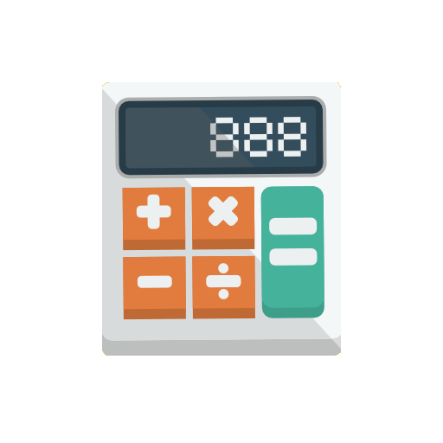
Operators + and -
Addition (operator +):
Subtraction (operator -):
int a = 5;
int b = 7;
int sum = a + b;
// 12
int a;
int b;
cin >> a >> b;
int result = a - b;
printf("%d", result);
13

Slide 14

Operators * and /
Multiplication (operator *):
Division (operator /):
int a = 5;
int b = 7;
int product = a * b;
// 35
int a = 25;
int b = a / 4;
double f = a / 4.0;
int error = a / 0;
// 6 – no decimal point
// 6.25 – real number division
// Error division by 0
14

Slide 15
Numbers Division Behavior
Integer division will give result as an integer:
Floating point division will give result as a real number:
int a = 25;
printf("%d", a / 4);
printf("%d", a / 0);
// Integer result: 6
// Error division by 0
double a = 15;
printf("%f", a / 2.0);
printf("%f", a / 0.0);
printf("%f", 0.0 / 0.0);
// Result: 7.5
// Result: 1.#INF00
// Result: -1.#IND00

Slide 16
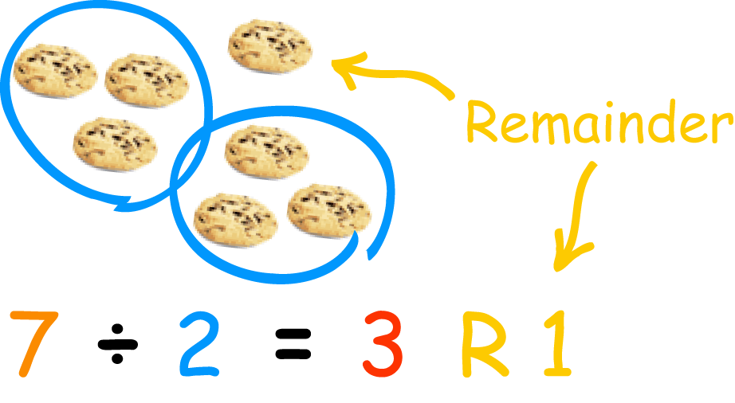
Operator %
Modulus Operator and remainder of after an integer division (operator %):
int a = 7;
int b = 2;
int product = a % b;
// 1
int odd = 3 % 2;
int еven = 4 % 2;
int error = 3 % 0;
// 1 – not an even number
// 0 – even number
// Error division by 0

Slide 17
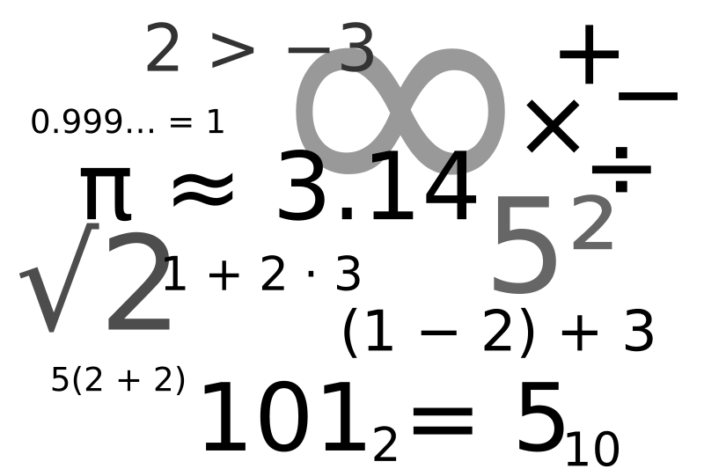
Equations
We can use the computer to calculate equations:
Calculate the area of trapezoid:
int expr = (3 + 5) * (4 – 2);
double b1, b2, h;
scanf("%lf%lf%lf", &b1, &b2, &h);
double area = (b1 + b2) * h / 2.0;
printf("%f\n", area);

Slide 18
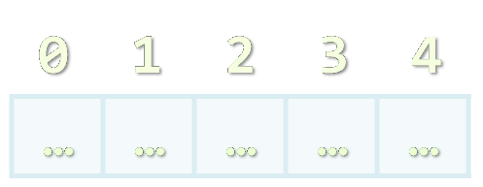
C Strings
Working with Text

Slide 19
C String
The C string is a sequence of characters stored inside the computer memory always ending with a null terminator.
This is actually an array of characters
Index | 0 | 1 | 2 | 3 | 4 | 5
value | H | e | l | l | o | \0
0
1
2
3
4
Element’s index
Array of 5 elements
…
…
…
…
…
Element of an array
19

Slide 20
C String
This object is always stored in sequential order.
In order to work with text there must be some place to store those characters
Declaration is almost the same as any other variable. The only difference is that the number of characters must be defined before compilation
Identifier
char text[10];
Size goes inside [] brackets
Data type
20

Slide 21
Reading Text
Reading text is similar to reading numbers:
Note here we do not use the & operator before the variable identifier this is because the type we pass is array of characters which is passed in a different way inside functions the array degenerates into a pointer
char text[100];
scanf("%s", text);
21

Slide 22
Important Notes
When reading text always make sure to have an array with at least enough size to save the text. It is way better to have larger arrays than smaller.
This means that you can declare those objects with large enough size. Example if you have to read names you can declare char array of 30 elements.
If you try to save text with more symbols than you have as an array the result is undefined behavior and in some cases segmentation fault.
22

Slide 23

Simple Calculations
Live Demo

Slide 24

Data Manipulation

Slide 25
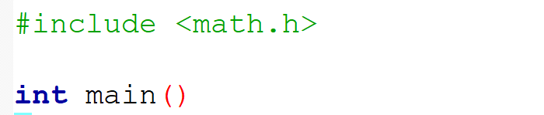
Working with Numbers
To use some functions on numbers you must include <math.h>
Rounding real numbers:
Round to the next integer:
Round to the previous integer :
double up = ceil(23.45); // 24
double down = floor(45.67); // 45

Slide 26
Working with Numbers
Round to the nearest integer:
Get absolute value of an integer number:
Get absolute value of a floating point number:
double near = round(45.67); // 46
int example1 = abs(-50); // 50
int example2 = abs(50); // 50
double example1 = fabs(-50.5); // 50.5
double example2 = fabs(50.5); // 50.5

Slide 27
Print Real Numbers
When printing real numbers you can specify the count of digits after the decimal point to be displayed
printf("%.2f", 50.5)); // 50.50
Sets the number of digits to the output

Slide 28
Type Casting
Types which "fit" into others can be assigned to them implicitly
For integer types, "fit" usually means requiring less bytes
E.g. char a = 'a'; int i = a; is a valid operation
But int i = 97; char a = i; is not
For floating point, float fits into double
If you really want to store a "bigger" type in a "smaller" type:
Explicitly cast the "bigger" type to the "smaller" type: small_type small_var = (small_type)big_var;
Can lose accuracy if value can’t be represented in "smaller" type

Slide 29
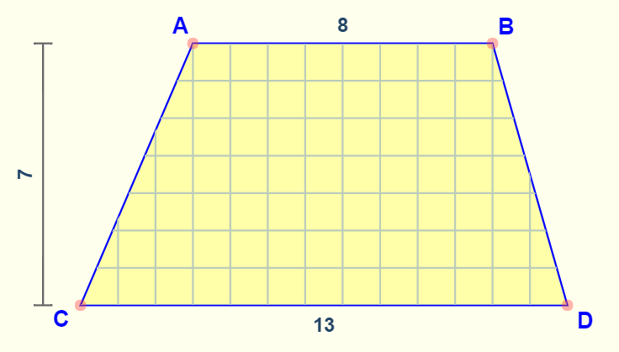
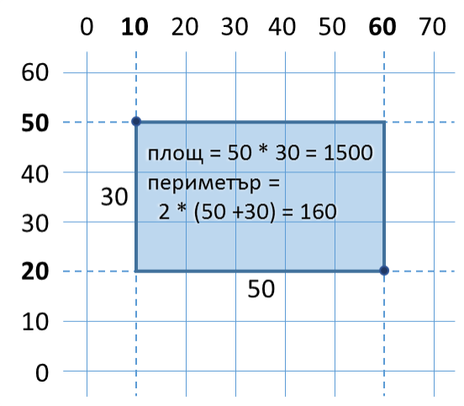
Areas of Geometric Sahpes
Live Demo

Slide 30
Circle Area and Perimeter
Read circle radius and calculate the area and perimeter
Area = π * r * r
Perimeter = 2 * π * r
Example:
π ≈ 3.14159265358979323846…
C
O
78.5398
31.4159
452.389
75.3982
D = 2*R
5
12
R

Slide 31
Read radius
Calculate area
Calculate perimeter
Print area
Print perimeter
31

Slide 32

Summary
Reading input
Data types
Working with text
Working with numbers
Formatting output
Type casting
…
…
…

Slide 33
Questions?
Notes:
33

Slide 34












SoftUni Diamond Partners

Slide 35




SoftUni Organizational Partners

Slide 36
Trainings @ Software University (SoftUni)
Software University – High-Quality Education, Profession and Job for Software Developers
softuni.bg, softuni.org
Software University Foundation
softuni.foundation
Software University @ Facebook
facebook.com/SoftwareUniversity
Software University Forums
forum.softuni.bg
36
Notes:
36

Slide 37

License
This course (slides, examples, demos, exercises, homework, documents, videos and other assets) is copyrighted content
Unauthorized copy, reproduction or use is illegal
© SoftUni – https://softuni.org
© Software University – https://softuni.bg
Notes:
37

